Slide 1




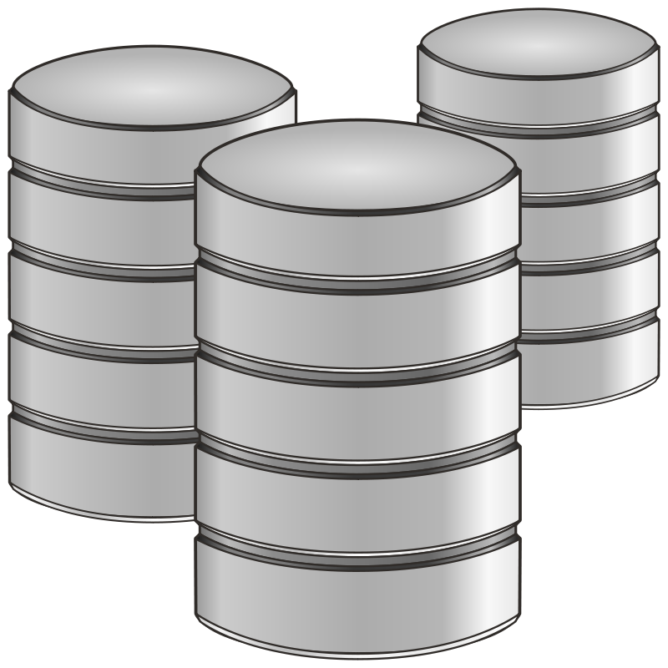


Most Relevant 5 documents
Question
Re-Ranking Model
BAAI/bge-reranker-v2-m3
Search Vector Database
Top 20 Docs
Intensive cleaning & Strategic Chunking
Create Vector Database
Embedding model: Alibaba-NLP/gte-large-en-v1.5
The Entire Doc: PDF & Word.
Image created by Professor on Zindi

